Slide 1
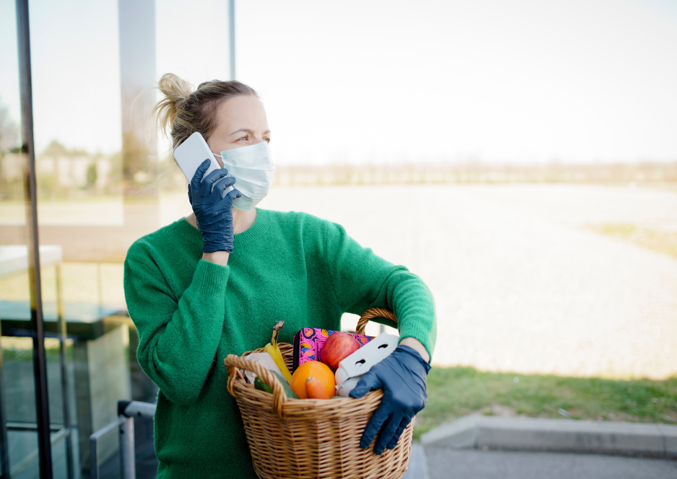
Giving Trends in the UK
Themes from UK giving and UK Charity polling
Rhodri Davies, Head of Policy
Daniel Ferrell-Schweppenstedde, Policy Manager
Catherine Mahoney, Research Manager
Charities Aid Foundation
#LondonFundersEvent #UKGiving @CAF @LondonFunders

Slide 2
Introducing caf
One of Europe’s largest foundations.
Last year, we granted £700 million to charity
A charity, a bank and a champion for better giving.
A major provider of financial services to charities.
Working across six continents, CAF works with more than 3,400 businesses, 200,000 donors and 79,000 charities to transform people’s lives around the world.

Slide 3
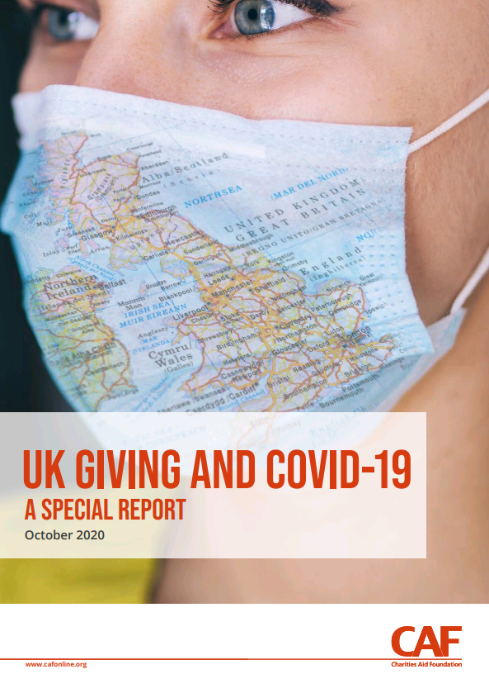
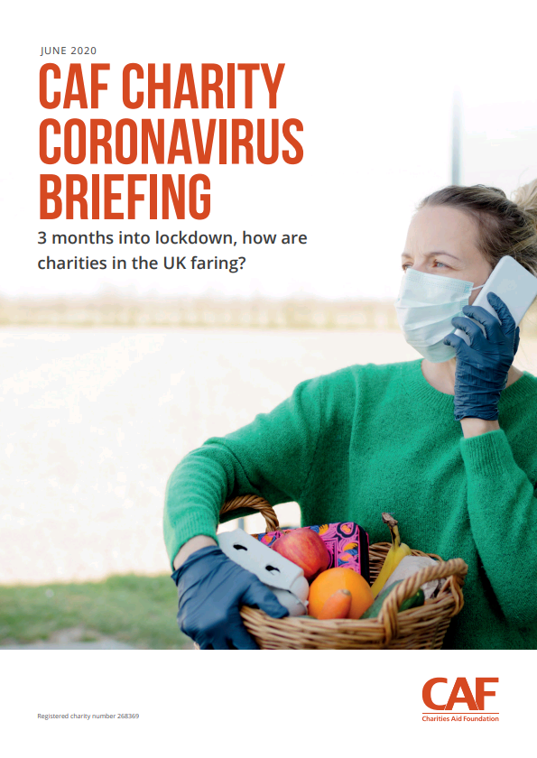
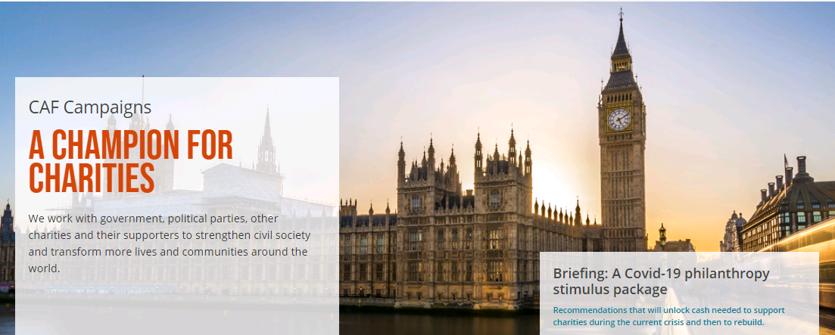
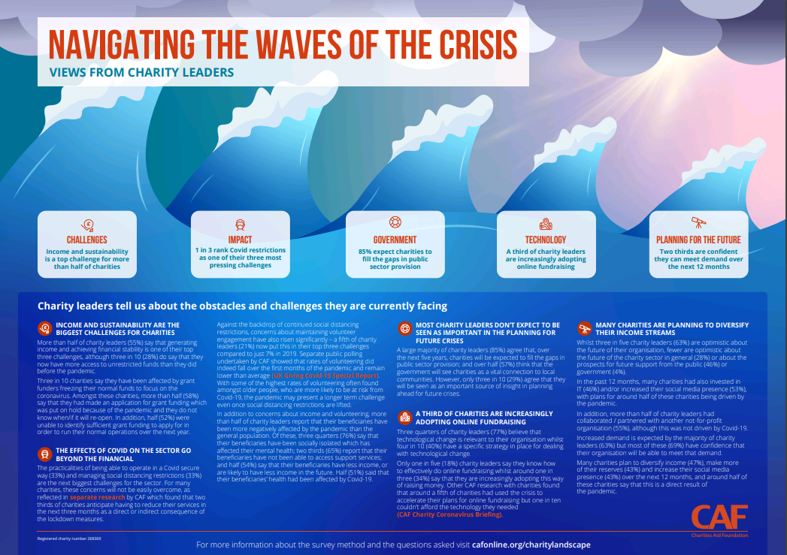
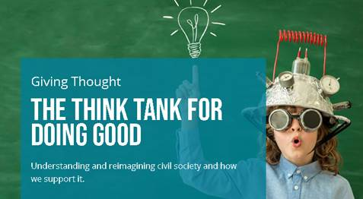
Overview of CAF’s research and policy work

Slide 4
Donation levels remained normal during the first lockdown
Q. Which of the following have you done in the last four weeks? Make a donation to charity.
Lockdown 1

Slide 5
£5.4 billion compared to £4.6bn for the same period in 2019

Slide 6
In early april, For some charities the outlook was poor
If the lockdown continues, how long will it be before your organisation has to shut its doors for good?

Slide 7
Percentage of donors giving to hospitals and hospices in the last four weeks
Q. Which of the following causes have you given to in the last four weeks?
Q. Which of the following causes have you given to in the last four weeks? Please tick all that apply. Base, all donors in the last four weeks; c. 350 each month. Source: CAF UK Giving Survey. The survey is conducted online each month by YouGov and is nationally representative. Data is weighted to variables including age, gender, region, and social grade. Percentages are shown as whole numbers but underlying data is rounded to two decimal places.

Slide 8
Online giving made up some of the large decline seen in cash giving
Proportion of recent donors who gave via cash or website/app in the last four weeks

Slide 9
For some charities, The crisis accelerated innovation
Which, if any, of the following applies to your charity?
One in five accelerated plans for online fundraising
One in five are concerned about a shortfall in cash donations
One in ten can’t afford the technology

Slide 10
There was a sustained increase in trust in charities throughout 2020
2020 ave: 54%
Q. To what extent do you agree or disagree that most charities are trustworthy?
2017 ave: 51%
2016 ave: 50%
2019 ave: 50%
2018 ave: 48%

Slide 11
In march, Londoners were ready to respond
To what extent, if at all, are you likely to do each of the following in the near-future (i.e. in the next 3 months), as a result of the Coronavirus outbreak?
March 2020
March-July 2020
Donate food or personal hygiene products to a food bank
Join a local group set up to deal with the crisis
57% vs 45% UK Total
18% vs 13% UK Total

Slide 12
Londoners focussed their support towards the crisis
Q. To what extent, if at all, are you likely to do each of the following in the near-future (i.e. in the next 3 months), or have you already done as a result of the Coronovirus outbreak?
Q. Have your donation habits changed in any of the following ways because of the coronavirus?
April - August 2020

Slide 13
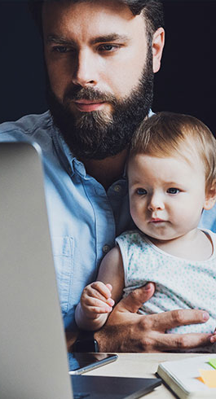
Both in the UK and internationally
June- August 2020
June – August 2020
Likely to Focus charitable giving on international charities as the pandemic intensifies in poorer countries
Donated to international charities
15% vs 9% UK Total
20% vs 14% UK Total
To what extent, if at all, are you likely to do each of the following in the near-future (i.e. in the next 3 months), or have you already done as a result of the Coronovirus outbreak?
Base, UK Adults, n=3948, London, n=381

Slide 14
What drives giving?
Behaviour
Why do people give?
channels
How are people able to give?
market
What are people being asked to give to?
Economy
Policy & Regulation
Tech & Innovation
Culture
Pandemic
Brexit

Slide 15
Digital is the new normal
Source: ONS, 2021

Slide 16
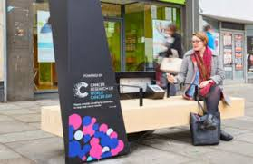
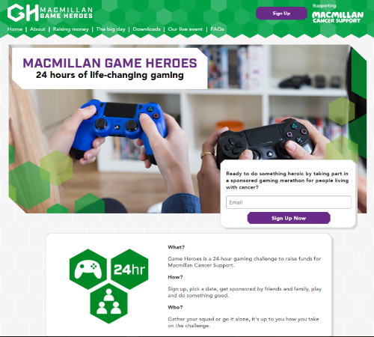
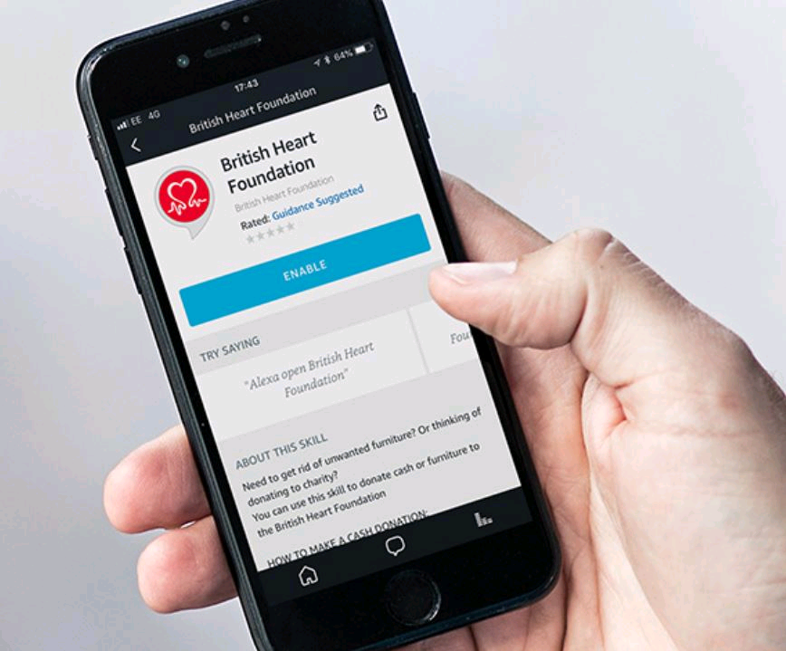
A wide range of channels

Slide 17
the impact of the pandemic and the digital deficit
With social distancing restrictions ongoing, to what extent do you agree or disagree with the following statements?

Slide 18
Broadening the landscape of doing good
What do individuals consider as ‘giving’?
Participation gaining importance (mutual aid, social movements)
Digitally-enabled networks emerging alongside traditional charities
Blending giving and commercial transactions (cause-related marketing, ethical shopping, businesses defining purpose)
Peer-to-peer giving gaining importance?

Slide 19
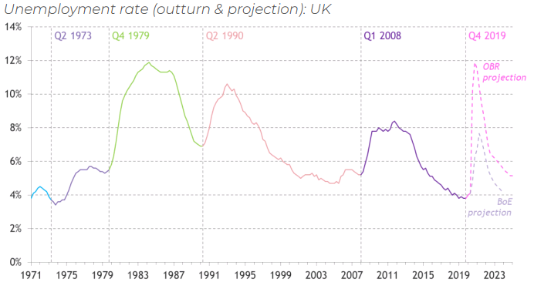
Short and medium term economic outlook
Source: Pro Bono Economics, 2020

Slide 20
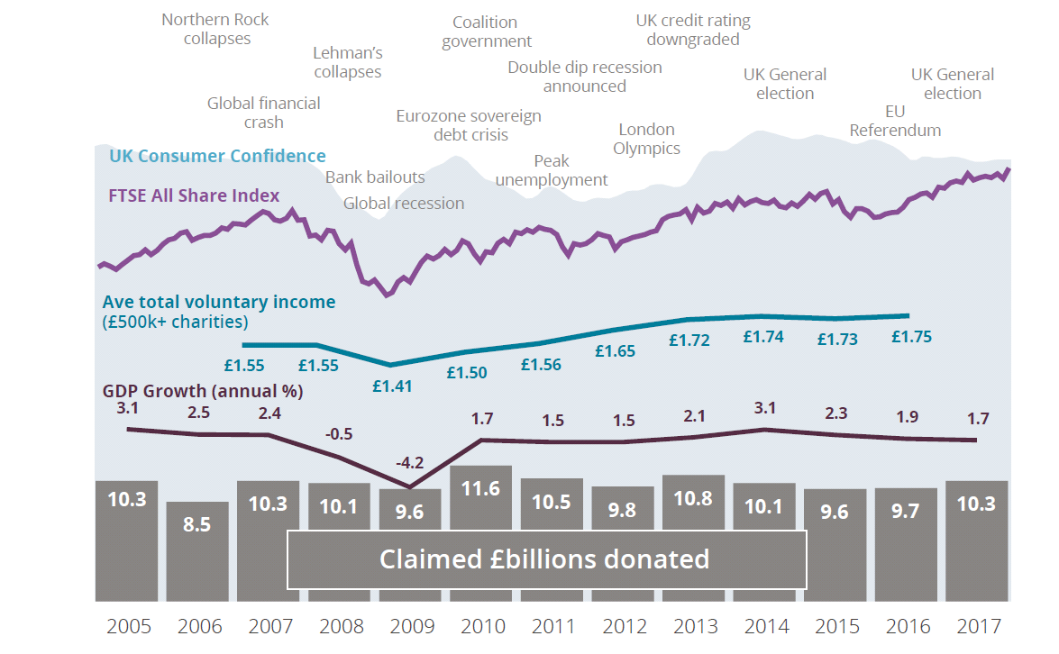
The long term outlook

Slide 21
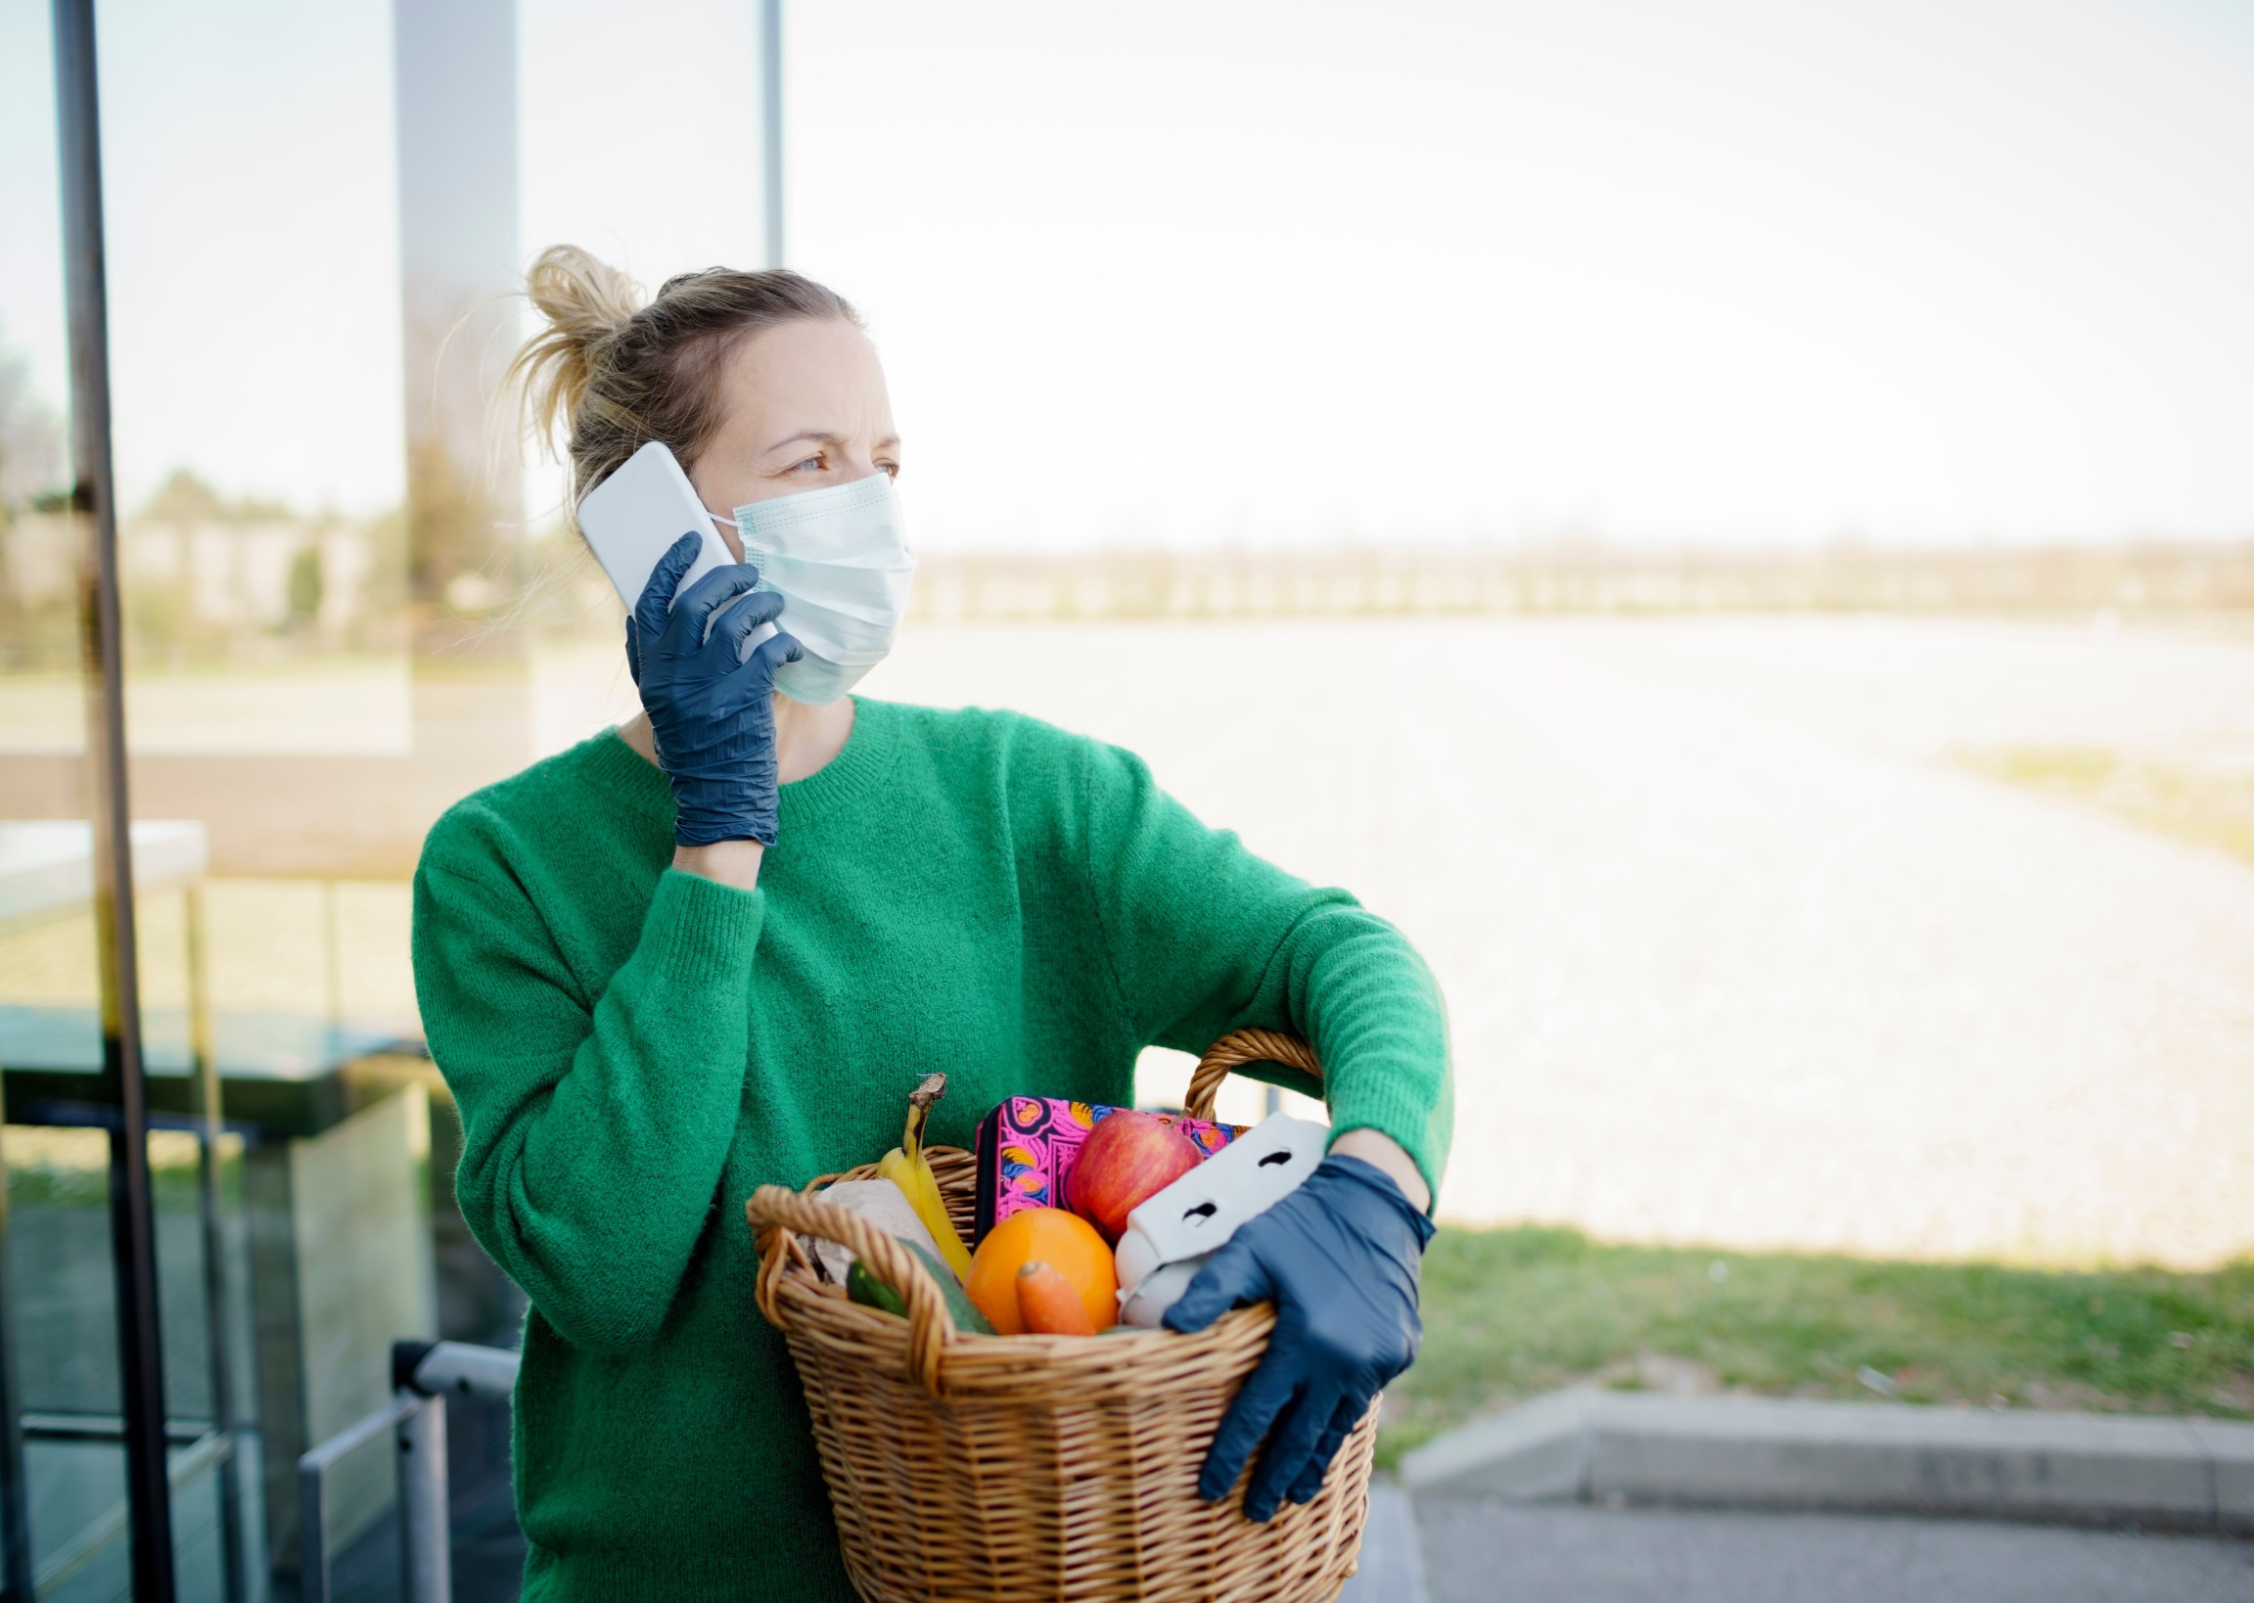
In summary
People continued to tell us they were donating to charity. Has there been a widening of the the landscape for what giving means?
Cash giving saw a big decrease. Digital transformation will be key.
There were some (apparently) temporary changes in what people gave to. Will any of these new habits last?
Was the resilience of giving under the first lockdown a unique event – can we expect it to last?

Slide 22
Thank you

